Slide 1
Depression, Defection and Deception!
1 Samuel 27

Slide 2

Don’t grow weary in well doing!
Matthew 14:30-31 But when he saw the wind boisterous, he was afraid; and beginning to sink, he cried, saying, Lord, save me. 31 And immediately Jesus stretched forth his hand, and caught him, and said unto him, O thou of little faith, wherefore didst thou doubt?
Psalm 13:1-4 How long wilt thou forget me, O LORD? for ever? how long wilt thou hide thy face from me? 2 How long shall I take counsel in my soul, having sorrow in my heart daily? how long shall mine enemy be exalted over me? 3 Consider and hear me, O LORD my God: lighten mine eyes, lest I sleep the sleep of death; 4 Lest mine enemy say, I have prevailed against him; and those that trouble me rejoice when I am moved.

Slide 3
Psalm 13:5-6 But I have trusted in thy mercy; my heart shall rejoice in thy salvation. 6 I will sing unto the LORD, because he hath dealt bountifully with me.
Galatians 6:9 And let us not be weary in well doing: for in due season we shall reap, if we faint not.
Lamentations 3:22-26 It is of the LORD'S mercies that we are not consumed, because his compassions fail not. 23 They are new every morning: great is thy faithfulness. 24 The LORD is my portion, saith my soul; therefore will I hope in him. 25 The LORD is good unto them that wait for him, to the soul that seeketh him. 26 It is good that a man should both hope and quietly wait for the salvation of the LORD.

Slide 4
Is God with you? Then the only way you can fail is by giving up.

Slide 5
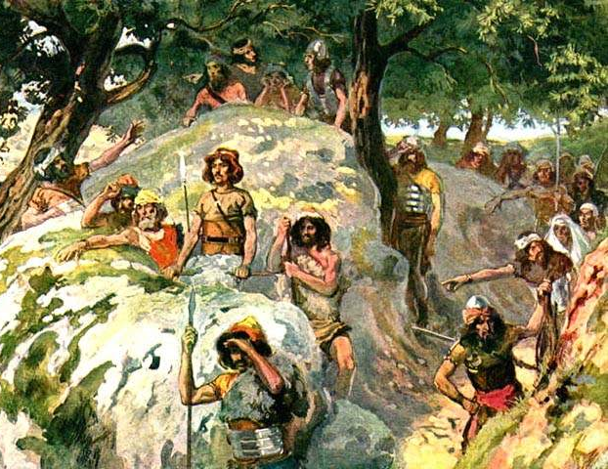
DEPRESSION.
Biblical reckoning demands that David’s thinking is a lie.
Your walk with God falters when you refuse to believe and agree with God.

Slide 6
1 Samuel 26:19 Now therefore, I pray thee, let my lord the king hear the words of his servant. If the LORD have stirred thee up against me, let him accept an offering: but if they be the children of men, cursed be they before the LORD; for they have driven me out this day from abiding in the inheritance of the LORD, saying, Go, serve other gods.

Slide 7
Psalm 27:1-4 The LORD is my light and my salvation; whom shall I fear? the LORD is the strength of my life; of whom shall I be afraid? 2 When the wicked, even mine enemies and my foes, came upon me to eat up my flesh, they stumbled and fell. 3 Though an host should encamp against me, my heart shall not fear: though war should rise against me, in this will I be confident. 4 One thing have I desired of the LORD, that will I seek after; that I may dwell in the house of the LORD all the days of my life, to behold the beauty of the LORD, and to enquire in his temple.

Slide 8
Jeremiah 17:9 The heart is deceitful above all things, and desperately wicked: who can know it?
The root issue: Notice that David is taking to himself and not the Lord.

Slide 9
If you get into your own head instead of in the Word, you’ll come to crazy conclusions.

Slide 10
Matthew 14:31 And immediately Jesus stretched forth his hand, and caught him, and said unto him, O thou of little faith, wherefore didst thou doubt?
Problem: David’s eyes are on his conditions and not on his Saviour.

Slide 11
Psalm 13:1-4 How long wilt thou forget me, O LORD? for ever? how long wilt thou hide thy face from me? 2 How long shall I take counsel in my soul, having sorrow in my heart daily? how long shall mine enemy be exalted over me?

Slide 12
DEFECTION!
Because he isn’t full of faith in God to keep him, David defects.
The picture? Notice that God isn’t mentioned or described in David’s life anywhere in chat 27!
In chpt 26, David met the threat head on.
Now he’s ready to live with the enemy!?
Remember where God told him to go?
1 Samuel 22:5 And the prophet Gad said unto David, Abide not in the hold; depart, and get thee into the land of Judah. Then David departed, and came into the forest of Hareth.

Slide 13
Hebrews 3:18-19 And to whom sware he that they should not enter into his rest, but to them that believed not? 19 So we see that they could not enter in because of unbelief.
KEY: Doubt kills belief because it elevates itself over against the promise of God!

Slide 14
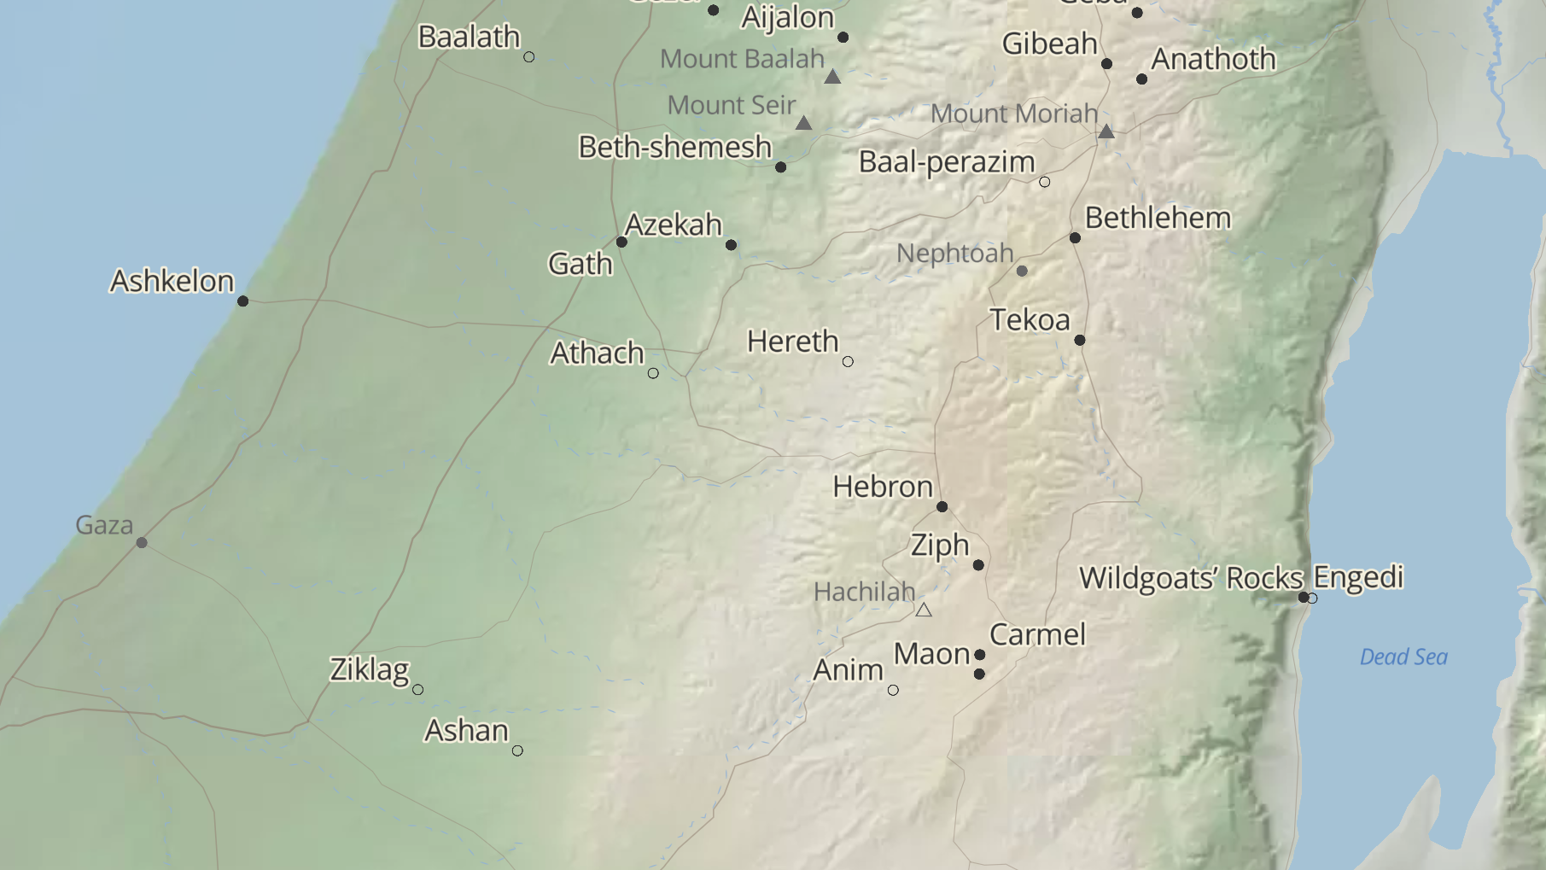
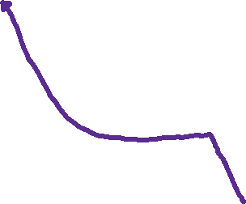

Slide 15
DEFECTION!
David looks for refuge and protection from the heathen instead of God.
“Maoch” means oppressed. To press, to emasculate.
David now is living (vs 3) with Achish “the son of oppression.”
David’s fear effects everyone!
Romans 14:7 For none of us liveth to himself, and no man dieth to himself.
Achish is a user.

Slide 16
DECEPTION.
David is trying to find “grace” from the wrong source.
BUT David is humble in how he presents himself to authority. This is wise.
Jude 1:8 Likewise also these filthy dreamers defile the flesh, despise dominion, and speak evil of dignities.
The world lives a life of deceiving and being deceived.

Slide 17


Slide 18
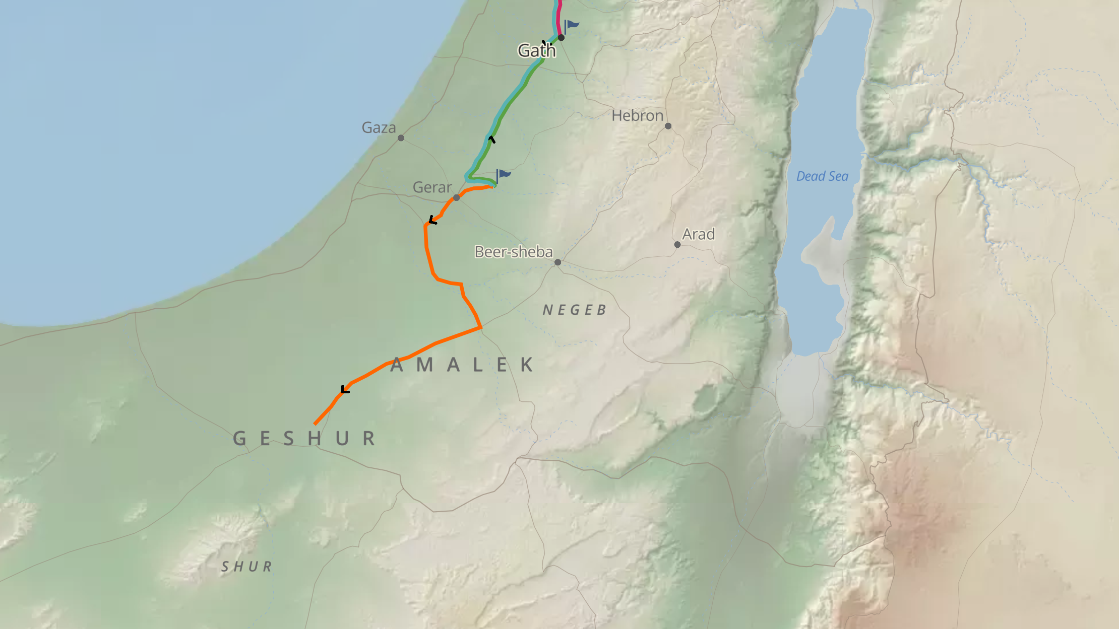

Slide 19
Romans 8:28 And we know that all things work together for good to them that love God, to them who are the called according to his purpose.

Slide 20
Deuteronomy 20:16-18 But of the cities of these people, which the LORD thy God doth give thee for an inheritance, thou shalt save alive nothing that breatheth: 17 But thou shalt utterly destroy them; namely, the Hittites, and the Amorites, the Canaanites, and the Perizzites, the Hivites, and the Jebusites; as the LORD thy God hath commanded thee: 18 That they teach you not to do after all their abominations, which they have done unto their gods; so should ye sin against the LORD your God.
This obeys Deuteronomy 20:16-18
which was still unfulfilled at David’s time.

Slide 21
These nations in the promised land were at war with God Himself.

Slide 22
DECEPTION.
David’s half truth covers a whole lie.
David brings the lie with the booty.
Ashish wanted to believe that David was now his to rule.
The world loves you as long as they think that they can take advantage of you.

